Slide 1
Beginner Machine Learning w/ R and/or Azure
How many crimes will be committed in Denver tomorrow?
Notes:
INTRO - NOT AN EXPERT
I’ve done a few of these before, and the ones that have been lame are the ones where I was an expert; however, i’ve always received excellent feedback when it’s a subject I’m newer to and excited about... So I don’t claim to be a guru in ML, Azure or R... so let’s dive in.
SIDE GIG, LEARNING SEXY I work a side-hustle for an ML company SalesTemp/PatientForecaster, but I have been working on all the ‘unsexy’ parts.. So I have been attempting to learn the exciting part of the business over the last month...

Slide 2
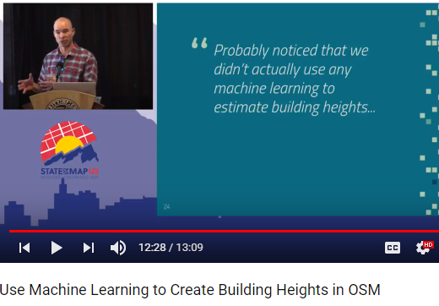
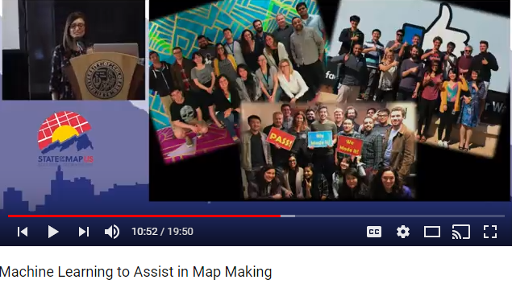
Most Data Science is presented as so hard it’s unusable w/o a huge team

Slide 3
I Disagree
Anyone with basic technical skills, can do basic ML in a weekend.

Slide 4
Machine Learning Steps
Ask the Right Question
Prepare the Data
Select the Algorithm
Training the Model
Test the model.
Repeat over and over.

Slide 5
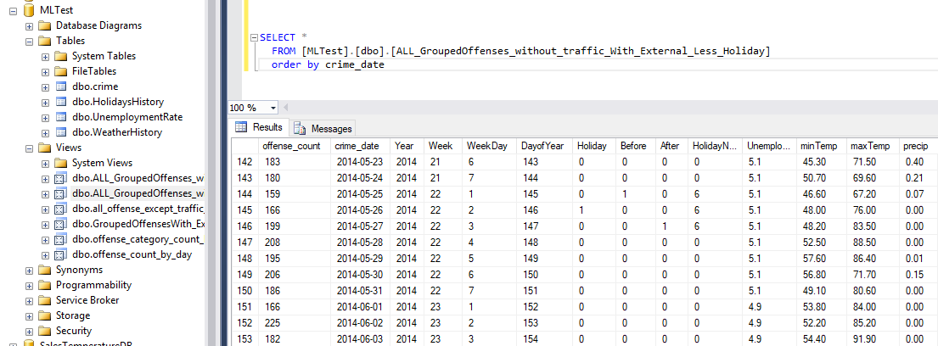
Data Prep
Usually 50-80% of the Time/Effort. Everyone underestimates the effort required for this step.
Notes:
3 PROCESSES Realistically you will need 3 different data processes.. History, Updates, Forecast.
NEVER FORMATTED / INDIVIDUAL CRIMES/ GROUPING Data is never in the format you need.. I was able to utilize some of the data I had already molded for those projects. The Crime data was by individual crime.. So I had to do a lot of grouping. Also I talked to subject matter experts that confirmed my suspicion that Crime would go up w/ Temp, but Accidents would be inverse, so I would need to split those.
HOW I did all of my prep in a local SqlServer, so I could use for both R and Azure - however both systems have many data prep tools.

Slide 6
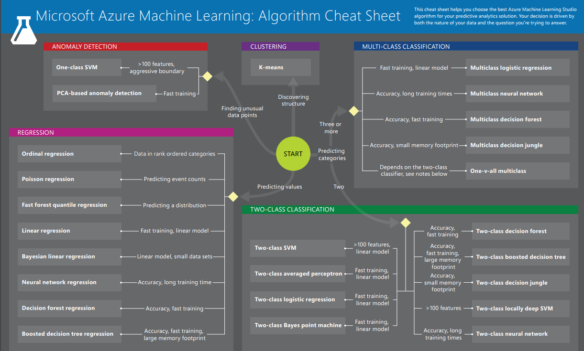
Data Split / Select Algorithm / Train
Normal is around 70% Training Data / 30% Test Data.
You must split your data, or you will by definition overstate your accuracy if you use your Test data for training. 4 Primary Algorithm Types Anomaly Detection Classification (2 Class / MultiClass) Clustering Regression
Link to Algorithm Cheat Sheet on last slide->
Notes:
You can NOT use test data in training, or by definition you will overstate your accuracy.

Slide 7
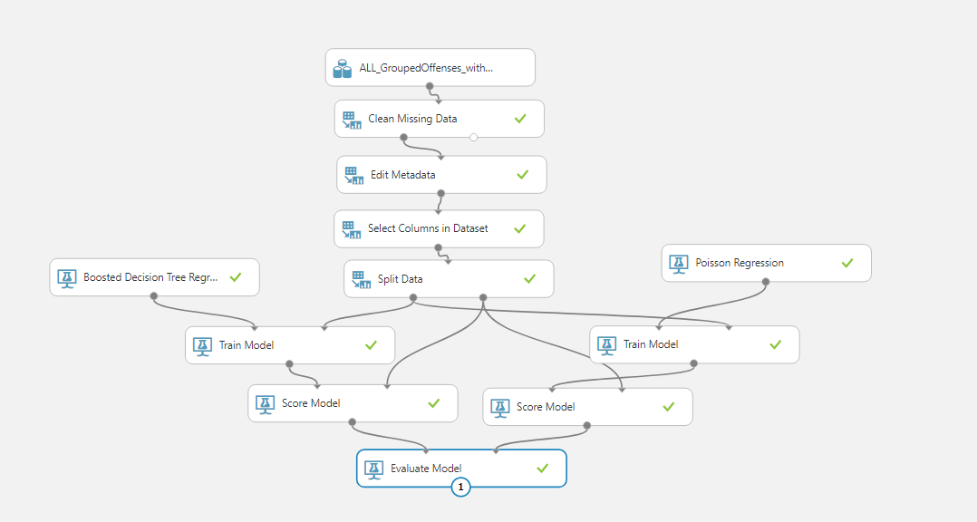
Notes:
Walk through Steps ... Drag and Drop.. Very Similar to SSIS if you’ve used that.
Define ‘Label Column’/ Train Column..
Split Data
Score allows you to evaluate data
Evaluate Model shows results
Includes integrated WebService to get future predictions based on Model Results.

Slide 8
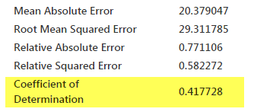
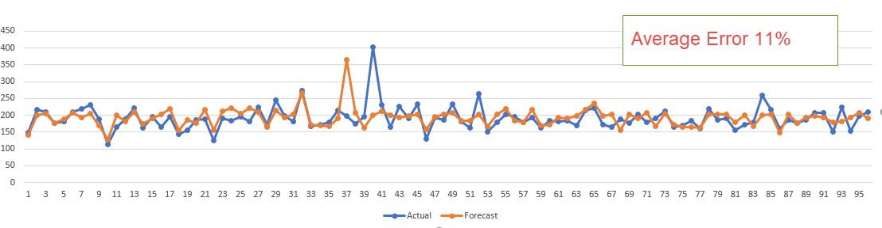
Evaluation of Model
Notes:
Coefficient of Determination is Rsquared.. The standard starting point.
How close the data is to a fitted Regression Line. 0 = Randomness (I believe based on the average) 1 = Perfect correlation.

Slide 9
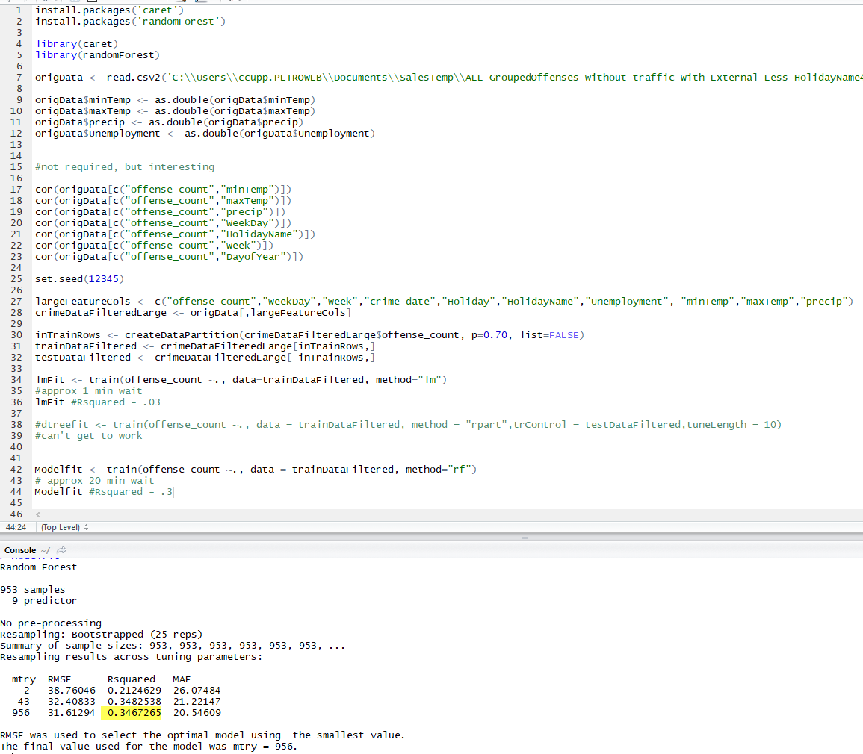
R
Notes:
WIDE ADOPTION/ BUT DIFFERENT TUTORIALS
LIBRARIES
ARCGIS and AZURE
R has wide adoption, but I found the documentation confusing. It is simple and straightforward in many ways. Like many languages these days it relies very heavily on 3rd Party Libraries (like caret)
R is THE Standard. But I used Classification tutorials and tried to convert them to my linear needs.. Perhaps if I’d started w/ a linear tutorial. (My Rsquared is very bad)
ArcGIS and Azure both offer options to pull in R scripts.
UCDenver’s GIS Analysis Class does use R, and several ML companies that I have spoken with use R.

Slide 10
Now what.
More Data.... Always more Data.
More History
Other Sources
Student Schedule
Events (Broncos, Rockies Games)
Realistic Scenario.. This would be a far superior/usable model if it was by precinct or neighborhood... and you would need GIS Skills.
Notes:
NEIGHBORHOOD
GIS
MILE HIGH
Looked at Data and noticed a spike on one day from a single address... Mile High Stadium.
IN THE REAL WORLD , you would want to do this by neighborhood/precinct...
And to do that you must use GIS. The ML folks won’t know how to ask..
-Which zip or airport do I use to get weather.
-Which zips are affected most by Events..
Use R inside your ArcGIS project.

Slide 11
Can be done w/ Pythons
Using NumPy and Pandas

Slide 12


Links
https://github.com/gcaseycupp/MLwithRandAzure gcaseycupp@gmail.com SalesTemperature: http://www.salestemperature.com/ ForecastER: http://www.patientforecaster.com/ Pluralsight - Azure ML: https://app.pluralsight.com/library/courses/azure-machine-learning-getting-started
Pluralsight - R: https://app.pluralsight.com/library/courses/r-understanding-machine-learning
Azure Algorithm Cheat Sheet: https://docs.microsoft.com/en-us/azure/machine-learning/studio/algorithm-cheat-sheet
Which Algorithm: https://blog.statsbot.co/machine-learning-algorithms-183cc73197c
Denver Crime Stats Home : https://www.denvergov.org/content/denvergov/en/police-department/crime-information/crime-statistics-maps/2015-crime-statistics-maps.html

Slide 13
Linksgm
Denver MileHigh MapTime Meetup : R Intro: https://github.com/rsteve388/Maptime-Introduction-to-R-/
Getting Data Science with R and ArcGIS: https://community.esri.com/videos/3269 ML with ArcGIS / R Bridge :: https://community.esri.com/videos/3343 https://learn.arcgis.com/en/projects/analyze-crime-using-statistics-and-the-r-arcgis-bridge/lessons/install-the-r-arcgis-bridge-and-start-statistical-analysis.htm
Intro to Machine Learning ; Udacity - Free - Python https://www.udacity.com/course/intro-to-machine-learning--ud120 Youtube Siraj Raval https://www.youtube.com/channel/UCWN3xxRkmTPmbKwht9FuE5A
DataScience w/ Python: https://docs.google.com/presentation/d/17UwfhctUTE1zKsBrHdMg43kybef9GtTOaNv2rf8Y4yo/edit#slide=id.g1f904a824b_0_232

